Slide 1
ENERGY RESOURCEFUL BLUETOOTH SWAPPING IN ANDROID DEVICES
PRESENTED BY
S.SURIYAN
GUIDED BY
Dr.R.U.Anitha., MCA., M.Phil., Ph.D

Slide 2
ABSTRACT
Bluetooth has transformed itself from a cable replacement technology to a wireless technology that connects people and machines.
In this process we propose a noble system to reduce the power that is wasted during the practice of Bluetooth in a well proficient style.
Here we propose a system to communicate between two android devices independently without any intermediate.

Slide 3
EXISTING SYSTEM
The existing system has a lot of drawbacks like more power usage while Bluetooth is in use.
Data delivery from one device to another device requires intermediate to transfer the data packets.
The existing system tools show less efficiency in data packet delivery due to intermediate interference.

Slide 4
PROPOSED SYSTEM
The project is to develop an android application for data transfer in a network without any intermediate interference.
The devices between the ranges can communicate with the help of the developed android application.
The power consumption due to the use of the application is reduces efficiently to make the application more effective.

Slide 5
NUMBER OF MODULES
Device Scanning
Device Authentication
Secure Transmitting
Connection Rescheduling
Energy reduction intended for Bluetooth convention

Slide 6
DEVICE SCANNING
Application is intended to scan or sensor devices that are near by or reachable to the range of Bluetooth from the mobile device.
The devices are scanned with less energy consumption from the device to increase power efficiency during the processing of the system.
Once the sensing is completed the device lists all the devices that are available to communicate. Thus allowing us to select a device to communicate.

Slide 7
DEVICE AUTHENTICATION
The devices that are available are listed the device is chosen to communicate.
Once the device is chosen an authentication request is sent to the native device to accept the connection.
This is done internally to reduce complexity to the user who used the application.
The authentication is accepted by the native device and then only the communication connection is made between the two device

Slide 8
SECURE TRANSMITTING
The destination node is chosen from the device the packet that re required to be sent to the destination is made ready.
And later the packets are sent in the Bluetooth network that is established between the two devices.
The packets that are send is directly delivered to the destination without using any intermediate for communication.

Slide 9
CONNECTION RESCHEDULING
The packets are received. Once the packets are sending from the source the packets travel through the Bluetooth network and reach the destination device.
The packets are received by the device and are processed. After processing the request the previous module is continued here to deliver packets from here to the source device.
Again the same process is repeated to deliver the packets.

Slide 10
ENERGY REDUCTION INTENDED FOR BLUETOOTH CONVENTION
The data communication between the devices is achieved using Bluetooth.
And the connection is peer to peer connection.
This is done by reducing the monitoring time of devices in the network often.
Here the monitoring is reduced and when ever needed it is implemented. Thus it helps in reducing the power consumption. Thus the system is made energy efficient.

Slide 11
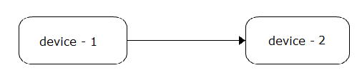
DATA FLOW DIAGRAM LEVEL-1

Slide 12
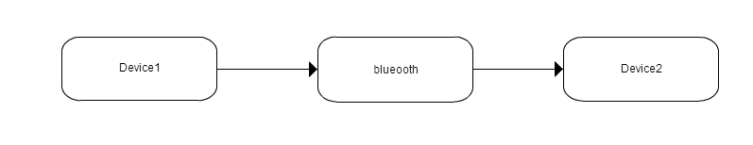
DATA FLOW DIAGRAM LEVEL-2

Slide 13
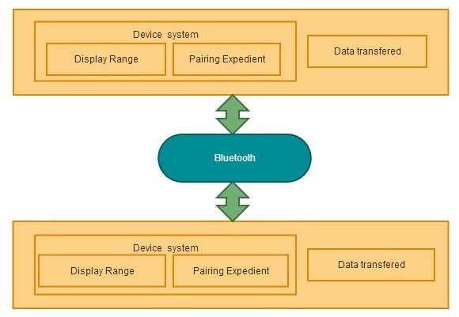
SYSTEM ARCHITECTURE

Slide 14
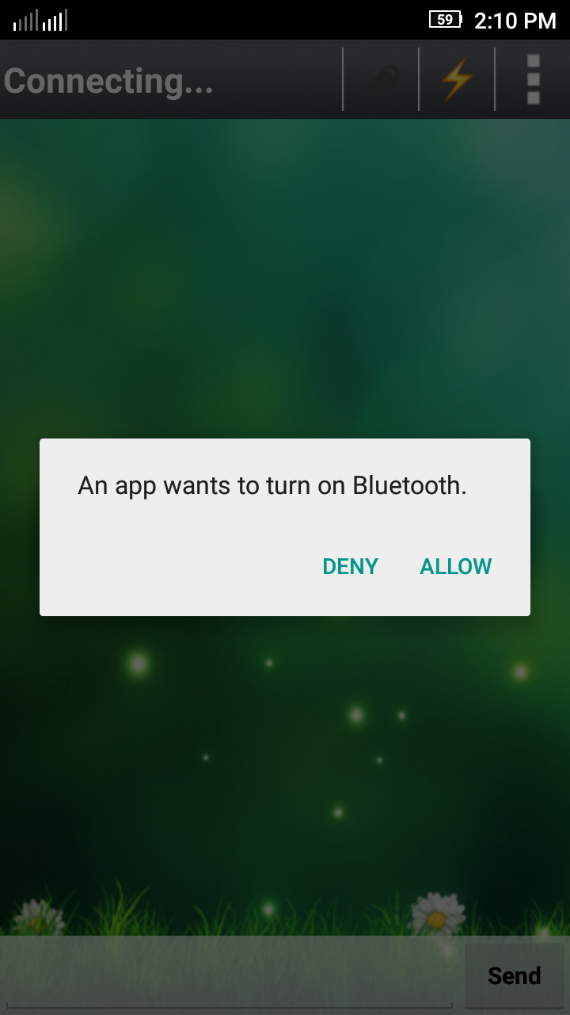
TURN ON BLUETOOTH
It is the Initial Step while open the app.

Slide 15
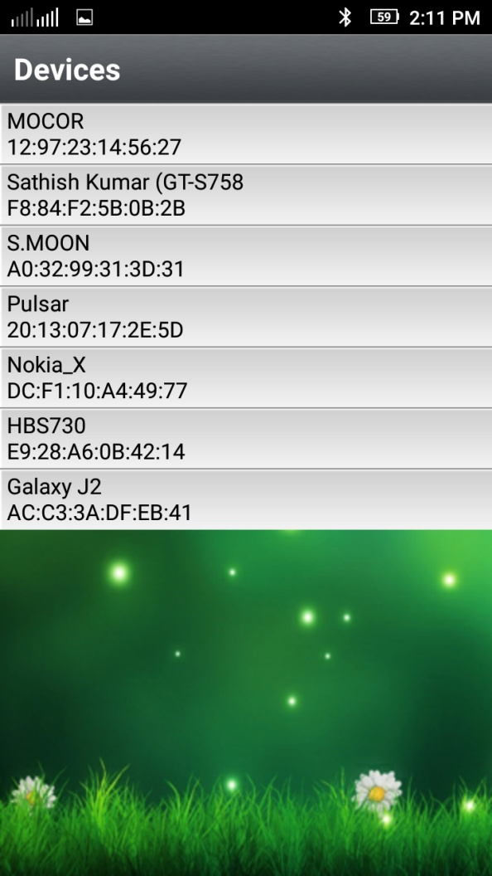
NEARBY DEVICES
Select name of the device to made a connection.

Slide 16
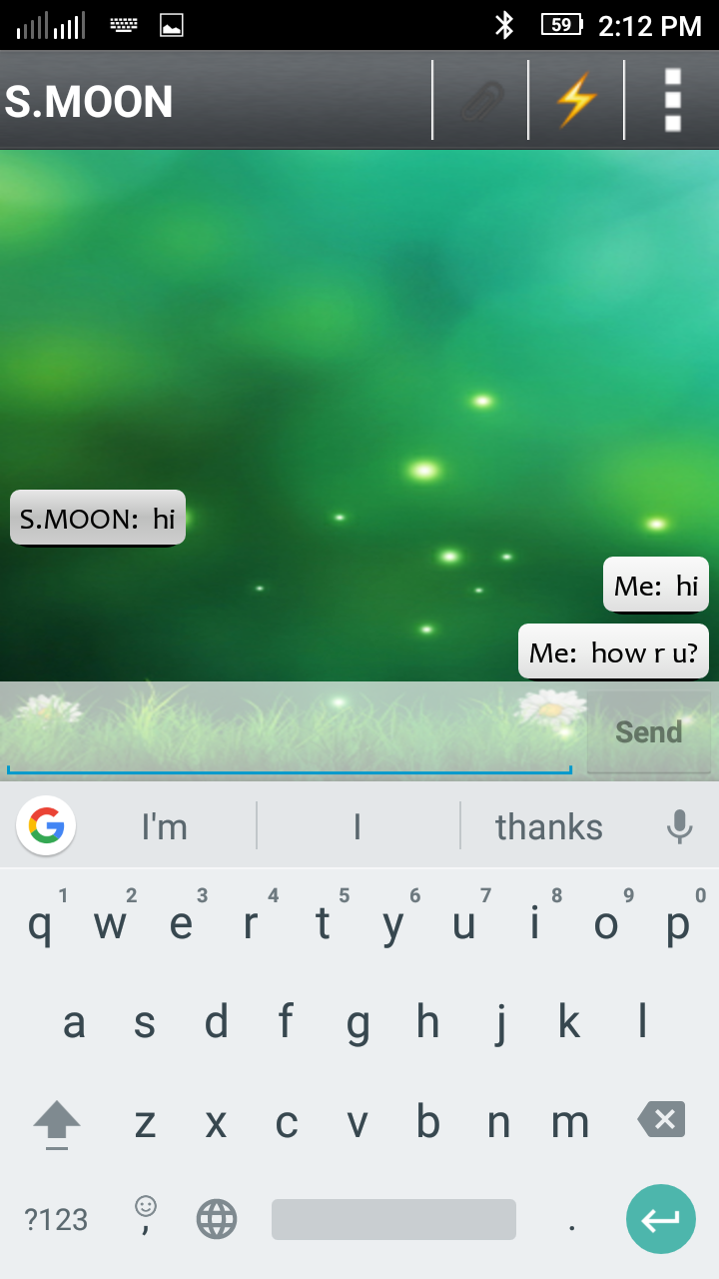
INSTANT CHAT
Chat instantly with destination device via Bluetooth.

Slide 17
INSTRUCTIONS FOR USE
EDIT IN GOOGLE SLIDES
Click on the button under the presentation preview that says "Use as Google Slides Theme".
You will get a copy of this document on your Google Drive and will be able to edit, add or delete slides.
You have to be signed in to your Google account.
EDIT IN POWERPOINT®
Click on the button under the presentation preview that says "Download as PowerPoint template". You will get a .pptx file that you can edit in PowerPoint.
Remember to download and install the fonts used in this presentation (you’ll find the links to the font files needed in the Presentation design slide)
More info on how to use this template at www.slidescarnival.com/help-use-presentation-template
This template is free to use under Creative Commons Attribution license. You can keep the Credits slide or mention SlidesCarnival and other resources used in a slide footer.

Slide 18
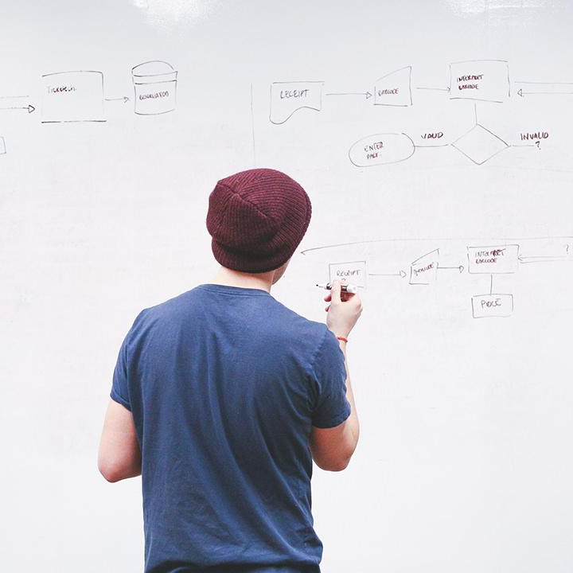
HELLO!
I am Jayden Smith
I am here because I love to give presentations.
You can find me at @username

Slide 19
TRANSITION HEADLINE
1
Let’s start with the first set of slides

Slide 20
Quotations are commonly printed as a means of inspiration and to invoke philosophical thoughts from the reader.

Slide 21
BIG CONCEPT
Bring the attention of your audience over a key concept using icons or illustrations

Slide 22
YOU CAN ALSO SPLIT YOUR CONTENT
White
Is the color of milk and fresh snow, the color produced by the combination of all the colors of the visible spectrum.
Black
Is the color of coal, ebony, and of outer space. It is the darkest color, the result of the absence of or complete absorption of light.

Slide 23
IN TWO OR THREE COLUMNS
Yellow
Is the color of gold, butter and ripe lemons. In the spectrum of visible light, yellow is found between green and orange.
Blue
Is the colour of the clear sky and the deep sea. It is located between violet and green on the optical spectrum.
Red
Is the color of blood, and because of this it has historically been associated with sacrifice, danger and courage.

Slide 24

A PICTURE IS WORTH A THOUSAND WORDS
A complex idea can be conveyed with just a single still image, namely making it possible to absorb large amounts of data quickly.

Slide 25
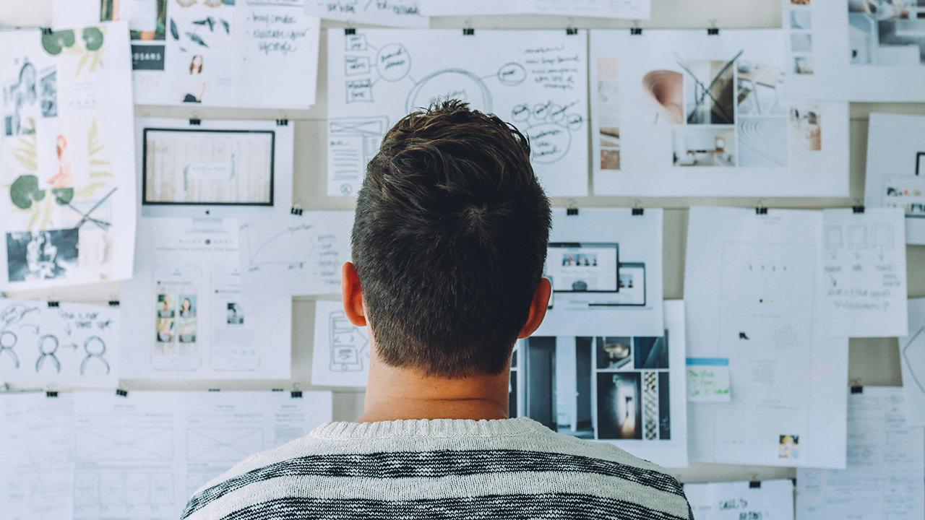
Want big impact?
USE BIG IMAGE

Slide 26
USE CHARTS TO EXPLAIN YOUR IDEAS
White
Gray
Black

Slide 27
AND TABLES TO COMPARE DATA
 | A | B | C
Yellow | 10 | 20 | 7
Blue | 30 | 15 | 10
Orange | 5 | 24 | 16

Slide 28
MAPS
OUR OFFICE

Slide 29
89,526,124
Whoa! That’s a big number, aren’t you proud?

Slide 30
89,526,124$
185,244 users
100%
That’s a lot of money
And a lot of users
Total success!

Slide 31
OUR PROCESS IS EASY
first
second
last

Slide 32
LET’S REVIEW SOME CONCEPTS
Device ScanningIs the color of gold, butter and ripe lemons. In the spectrum of visible light, yellow is found between green and orange.
Blue
Is the colour of the clear sky and the deep sea. It is located between violet and green on the optical spectrum.
Red
Is the color of blood, and because of this it has historically been associated with sacrifice, danger and courage.
Yellow
Is the color of gold, butter and ripe lemons. In the spectrum of visible light, yellow is found between green and orange.
Blue
Is the colour of the clear sky and the deep sea. It is located between violet and green on the optical spectrum.
Red
Is the color of blood, and because of this it has historically been associated with sacrifice, danger and courage.

Slide 33
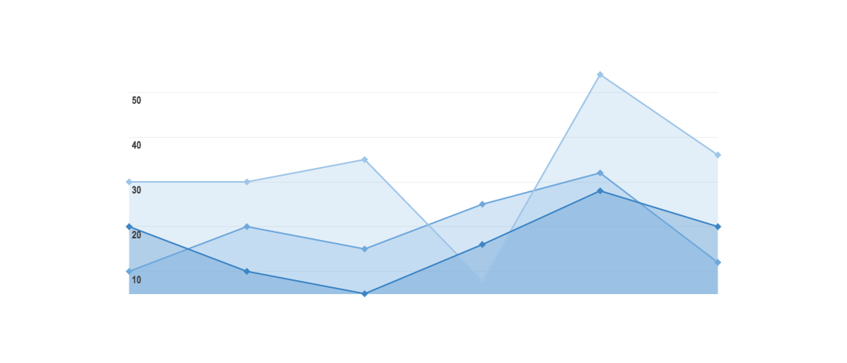
GRAPH TITLE
You can insert graphs from Google Sheets

Slide 34
iPHONE PROJECT
Show and explain your web, app or software projects using these gadget templates.
Place your screenshot here

Slide 35
Place your screenshot here
TABLET PROJECT
Show and explain your web, app or software projects using these gadget templates.

Slide 36
Place your screenshot here
DESKTOP PROJECT
Show and explain your web, app or software projects using these gadget templates.

Slide 37
THANKS!
Any questions?
You can find me at
@username & user@mail.me

Slide 38
CREDITS
Special thanks to all the people who made and released these awesome resources for free:
Presentation template by SlidesCarnival
Photographs by Startup Stock Photos

Slide 39
PRESENTATION DESIGN
This presentation uses the following typographies and colors:
Titles: Roboto Condensed
Body copy: Roboto Condensed
You can download the fonts on this page:
https://material.io/guidelines/resources/roboto-noto-fonts.html
Navy #3f5378 · Dark navy #263248 · Yellow #ff9800
You don’t need to keep this slide in your presentation. It’s only here to serve you as a design guide if you need to create new slides or download the fonts to edit the presentation in PowerPoint®

Slide 40
SlidesCarnival icons are editable shapes.
This means that you can:
Resize them without losing quality.
Change line color, width and style.
Isn’t that nice? :)
Examples:

Slide 41
😉
Now you can use any emoji as an icon!
And of course it resizes without losing quality and you can change the color.
How? Follow Google instructions https://twitter.com/googledocs/status/730087240156643328
✋👆👉👍👤👦👧👨👩👪💃🏃💑❤😂😉😋😒😭👶😸🐟🍒🍔💣📌📖🔨🎃🎈🎨🏈🏰🌏🔌🔑 and many more...

